Slide 1
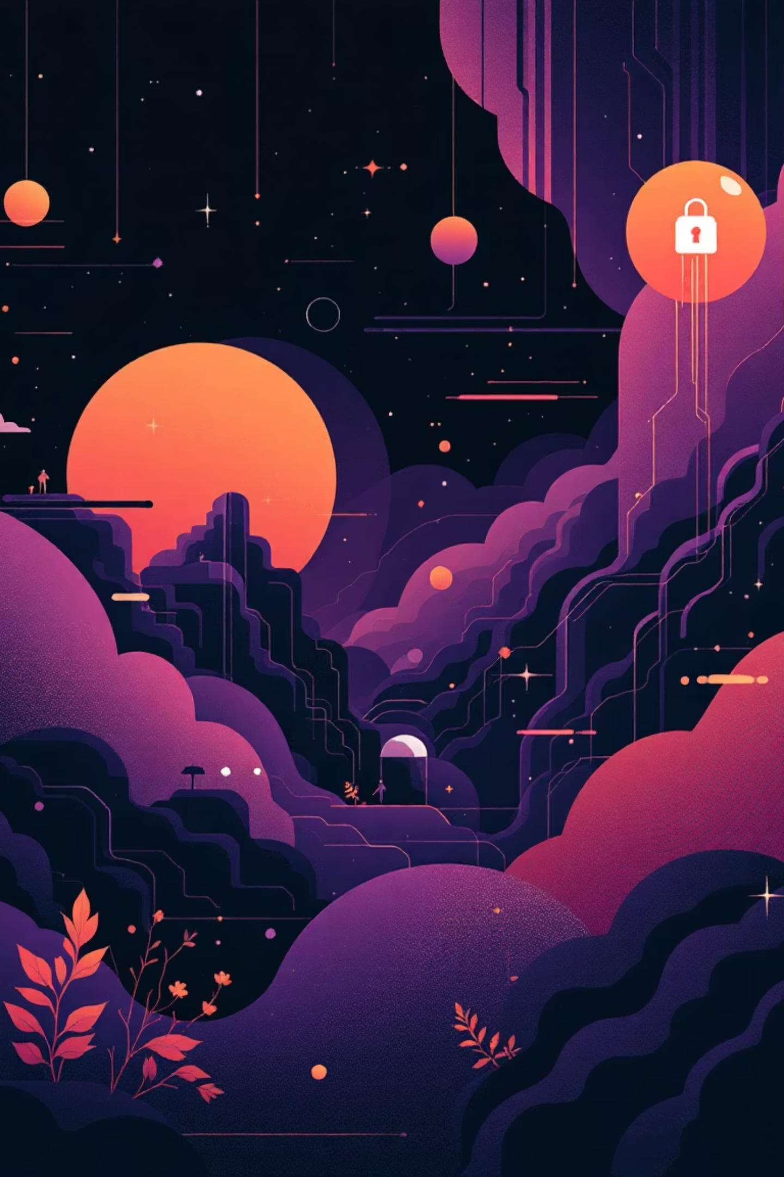
Cybersecurity: Shielding Your Life in the Digital Age
Every day, we generate over 2.5 quintillion bytes of data, and while the digital age brings convenience, it also harbors hidden threats. Cybersecurity acts as your digital seatbelt, protecting your life, money, and identity.

Slide 2
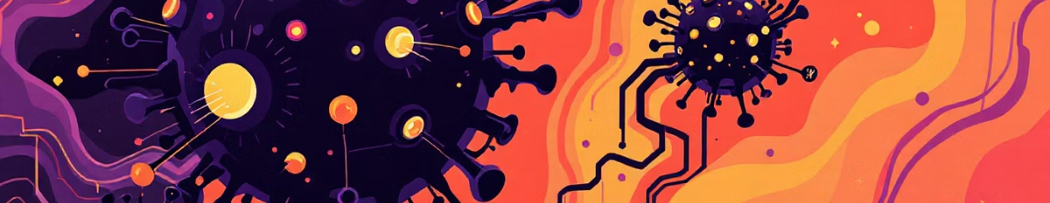
The Digital Double-Edged Sword
The Convenience
The Cost
Instant banking and payments
Identity theft risks
Social connection worldwide
Financial fraud and crime
Shopping at your fingertips
Personal data exposure
Information on demand
Digital blackmail threats

Slide 3

Understanding the Enemy: The Big Three Threats
Phishing Attacks
Malware & Ransomware
Weak Passwords
Deceptive emails, messages, or websites trick you into revealing sensitive information like passwords or financial details.
Malicious software infiltrates your system, from data-stealing viruses to ransomware that locks your files until a payment is made.
Easily guessable, reused, or short passwords are a major vulnerability, providing open doors for unauthorized account access.

Slide 4
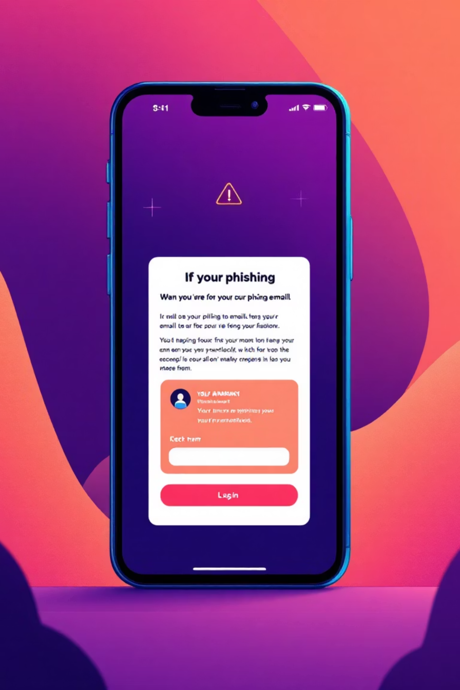
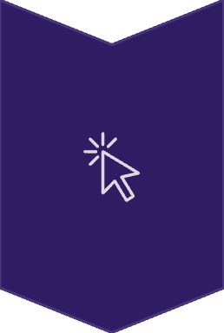
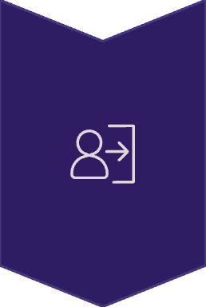
Phishing: Common Hooks & How It Works
Phishing attacks are a primary method used by cybercriminals. They leverage human psychology to gain access to sensitive information.
Common Hooks
Preys on fear, urgency, or greed through deceptive messages.
Asks for immediate action, often threatening negative consequences.
The Deceptive Click
You are lured to click a fake link, often disguised as a legitimate website or service.
Credential Theft
The fake website, designed to look authentic, steals your login credentials or personal data.

Slide 5
Phishing: The Pro Tip
Staying safe online requires vigilance and smart habits. Remember these crucial rules to protect yourself from phishing attempts:
NEVER Click Suspicious Links
Type Official Website Addresses Directly

Slide 6
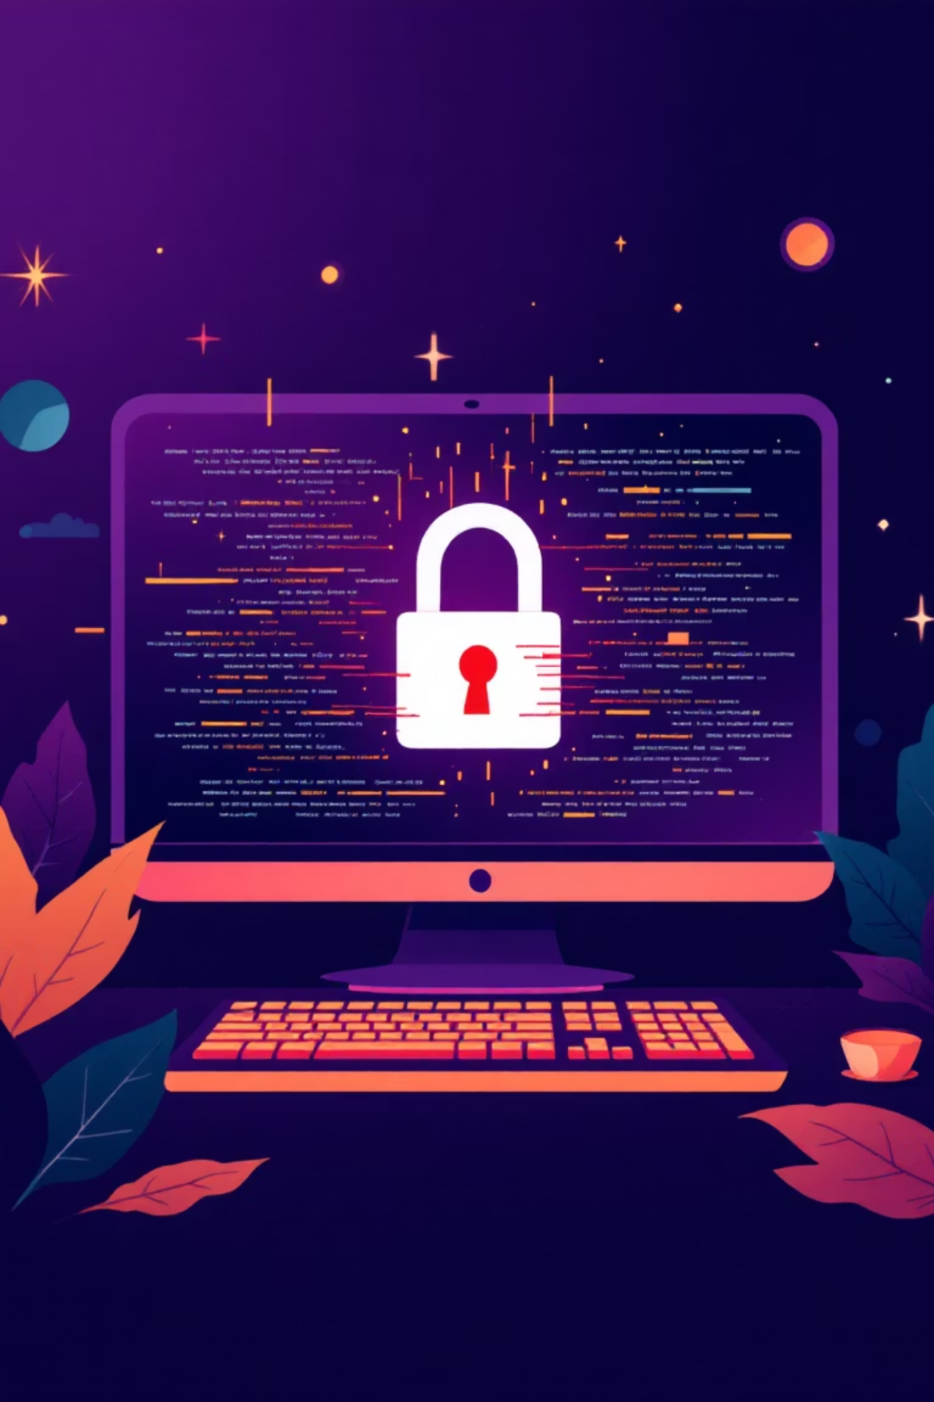
Malware & Ransomware: The Digital Sickness
Beyond phishing, malicious software directly threatens your devices and data. Understanding these digital sicknesses is crucial for prevention.
What is Malware?
What is Ransomware?
Malware is a broad term for harmful software like viruses, spyware, and Trojans. It's designed to infiltrate systems, damage data, disrupt operations, or steal sensitive information without consent.
Ransomware is a malicious malware that encrypts your valuable files or entire system. Attackers demand payment, often in cryptocurrency, for the decryption key.

Slide 7
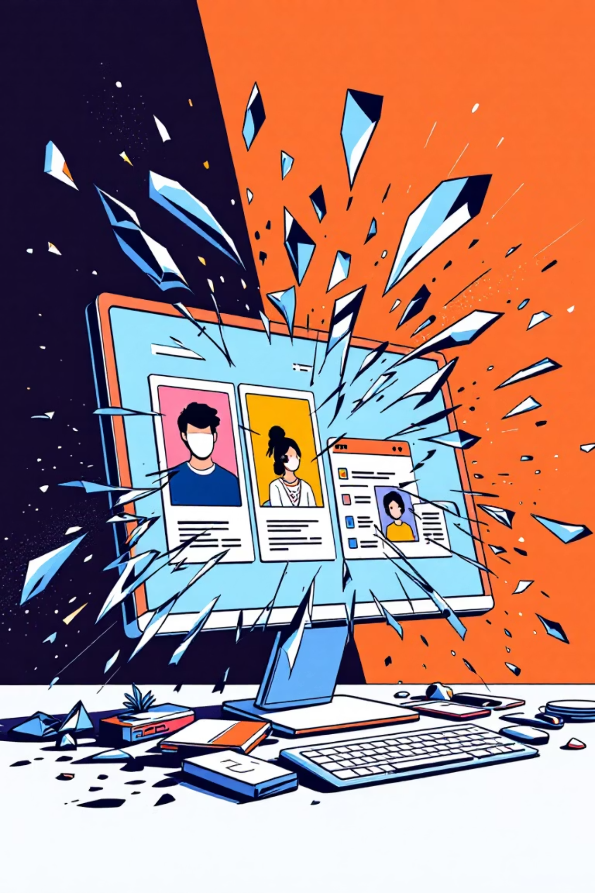
Malware & Ransomware: The Real Cost
The impact of a malware or ransomware attack extends far beyond just system compromise, leading to significant personal and financial repercussions.
Loss of Irreplaceable Digital Memories
Precious photos, family videos, and personal documents can be encrypted or wiped out forever, leaving emotional scars and irrecoverable losses.
System Downtime & Financial Loss
Businesses face operational paralysis, costly recovery efforts, legal fees, and reputational damage, leading to substantial financial setbacks.
Compromised Personal Information
Attackers may steal sensitive data, leading to identity theft, fraudulent transactions, or blackmail attempts, further jeopardizing your security.

Slide 8
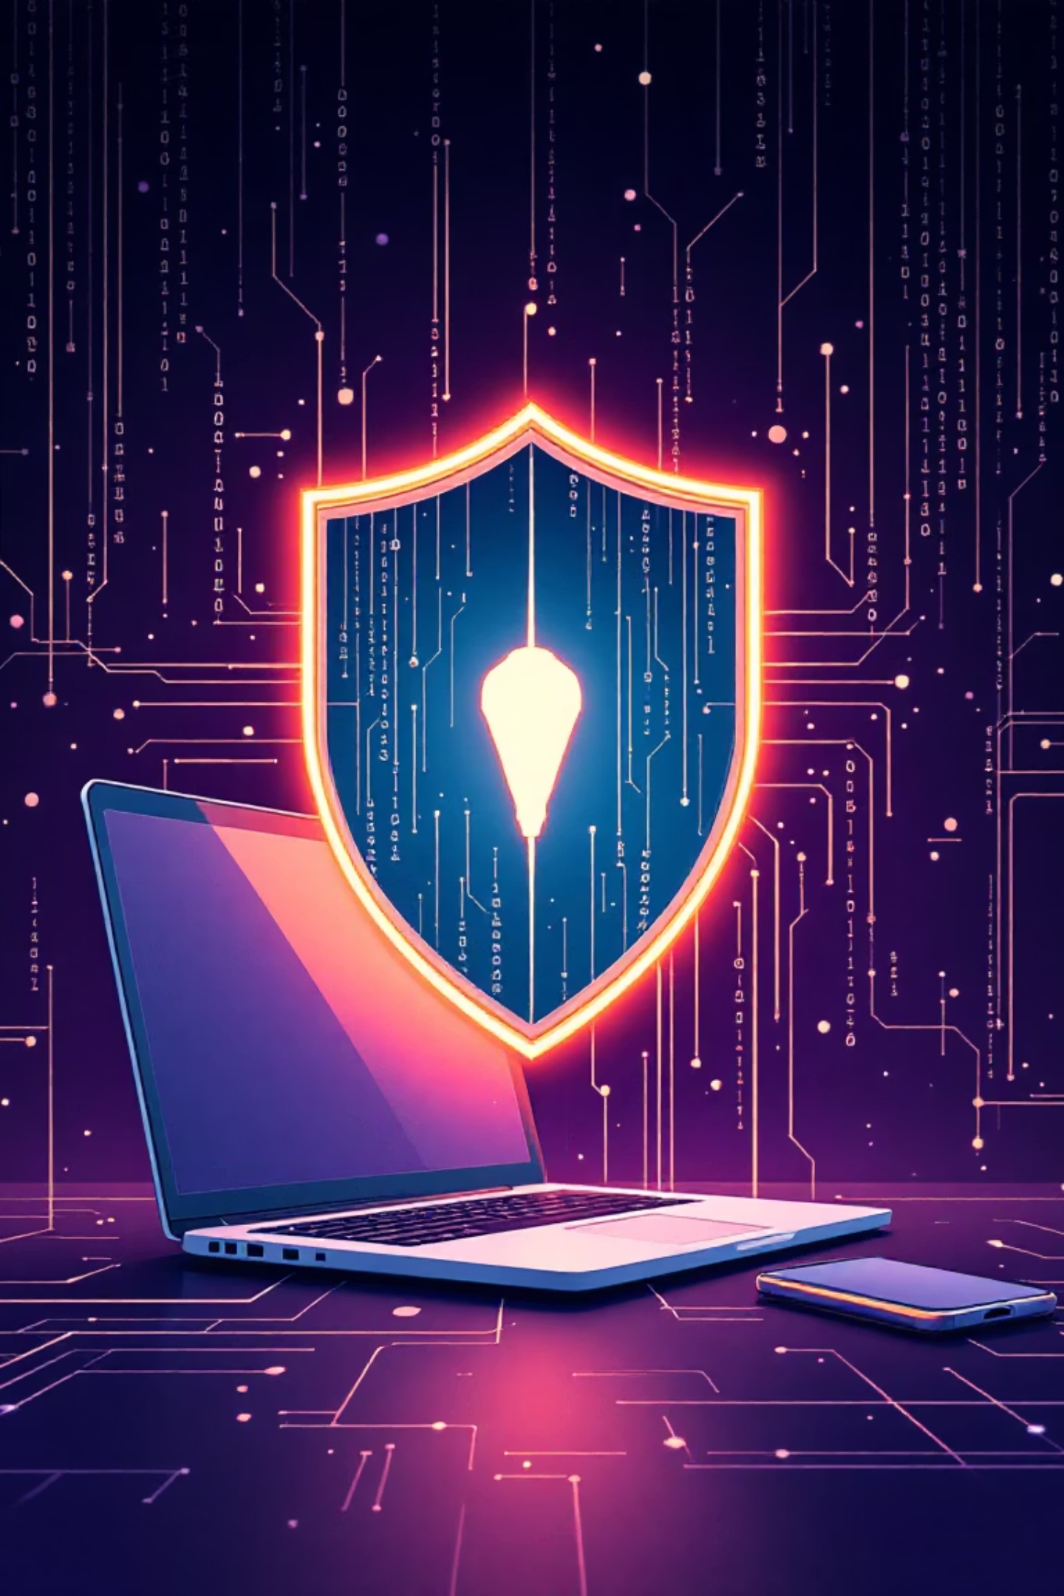
Malware & Ransomware: The Pro Tip
Proactive defense is key to safeguarding your digital life. One simple action can prevent countless attacks:
Prioritize Updates & Security Patches
Regularly updating your operating system and all software is your strongest defense, as updates include critical security patches.

Slide 9
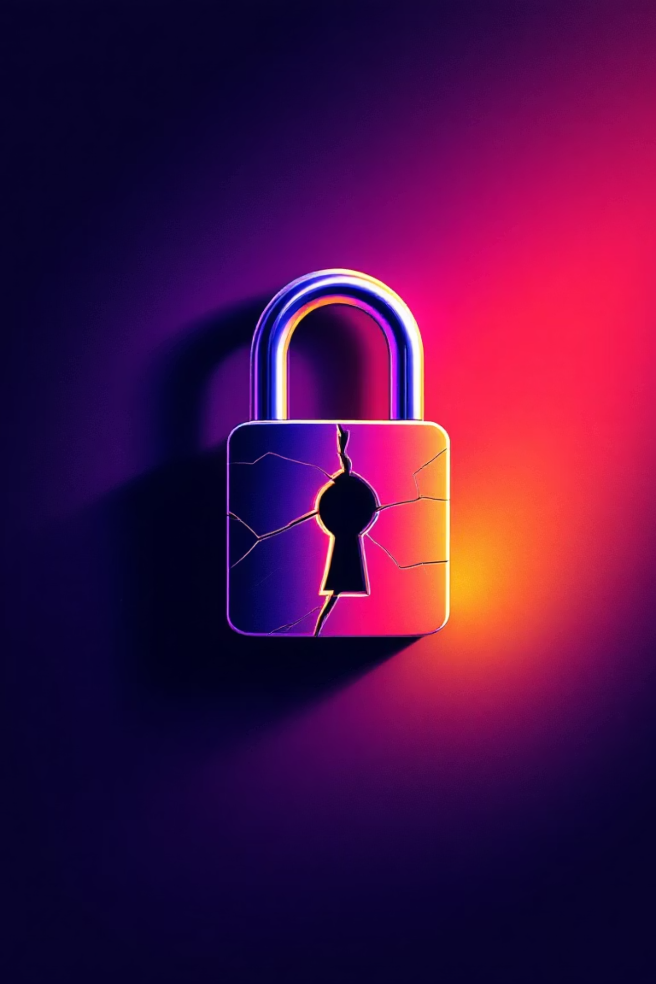
Weak Passwords: The Open Door
Your password is your digital key, but many still use simple, predictable combinations. These "easy-to-guess" passwords are a major risk, offering cybercriminals an open invitation to your personal information.
The Danger of Credential Stuffing
Hackers often acquire usernames and passwords from data breaches. They use this information in a technique called credential stuffing, which exploits password reuse to gain access to many other accounts.

Slide 10
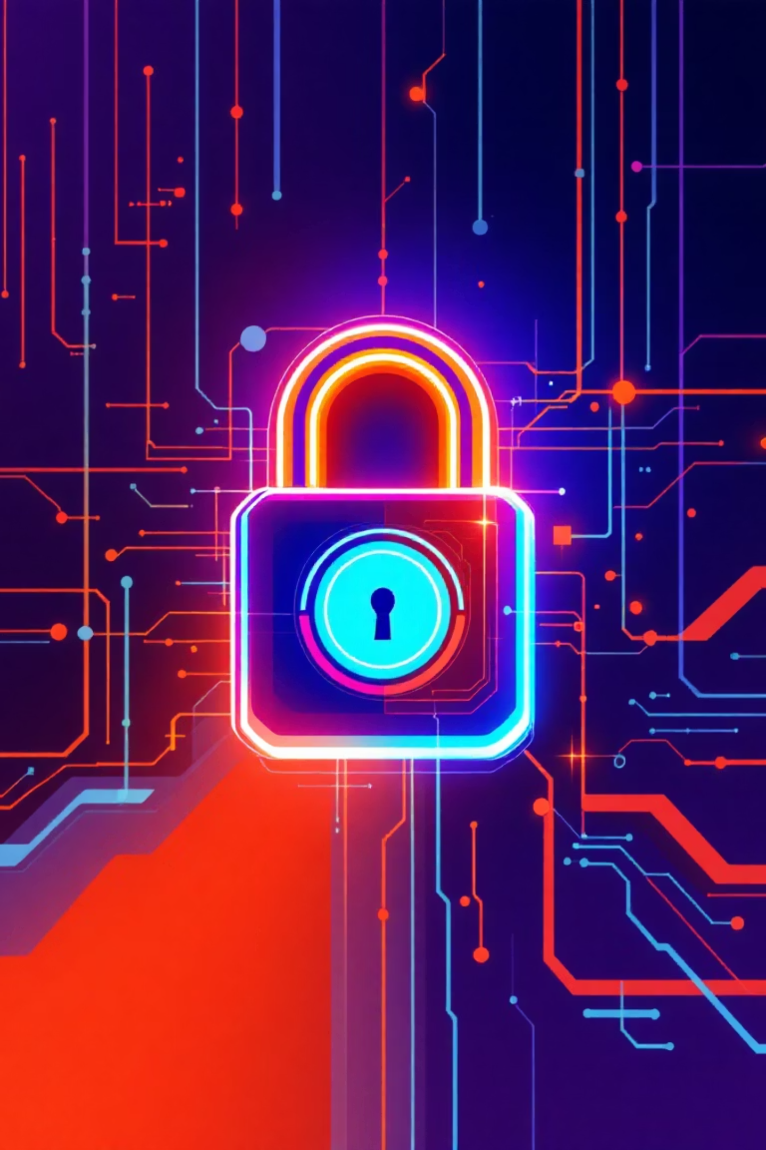
Weak Passwords: The Pro Tip
Your digital security is only as strong as your weakest password. Adopt these fundamental practices to create an impenetrable defense for all your online accounts:
Strong, Unique Passwords for Every Account
Craft distinct and complex passwords for each service, mixing uppercase and lowercase letters, numbers, and symbols.
Leverage a Reputable Password Manager
These essential tools securely generate and store all your complex passwords.

Slide 11
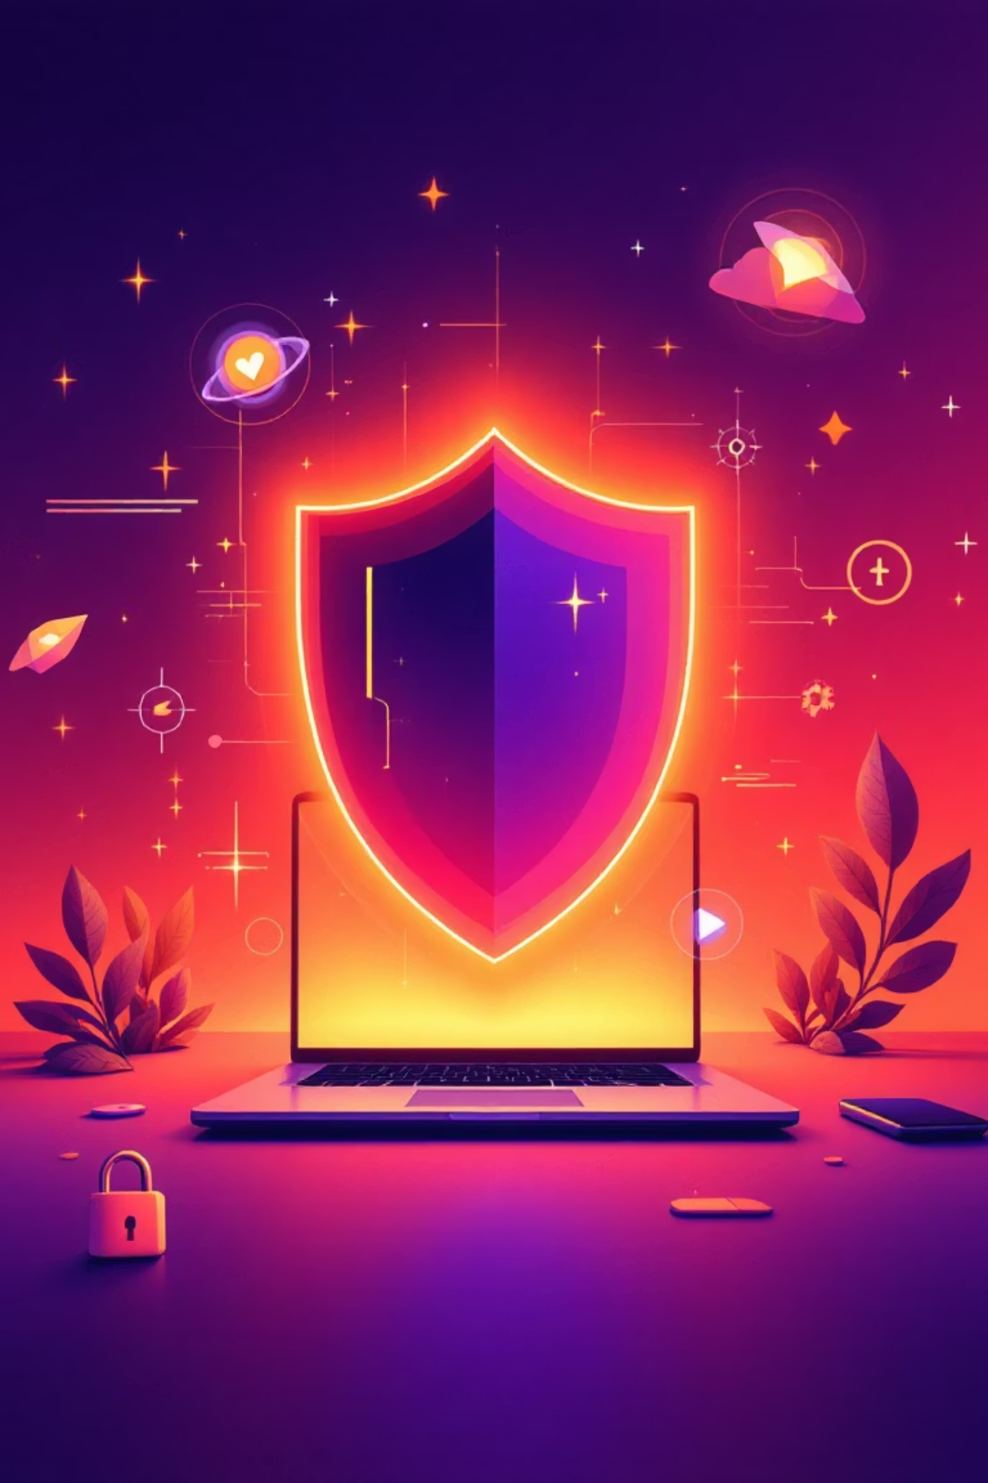

Your Digital Survival Kit: Simple Defenses
In the ever-evolving landscape of cyber threats, robust digital defenses are your first line of protection.
Multi-Factor Authentication (MFA)
Think Before You Click
Add an extra layer of security beyond just a password. MFA requires a second verification step, like a code from your phone.
Exercise caution with unexpected emails, links, and attachments.
Backup, Backup, Backup
Regularly back up your important data to external drives or cloud services. This ensures that your precious files are safe and recoverable, even if you fall victim to ransomware or data loss.

Slide 12
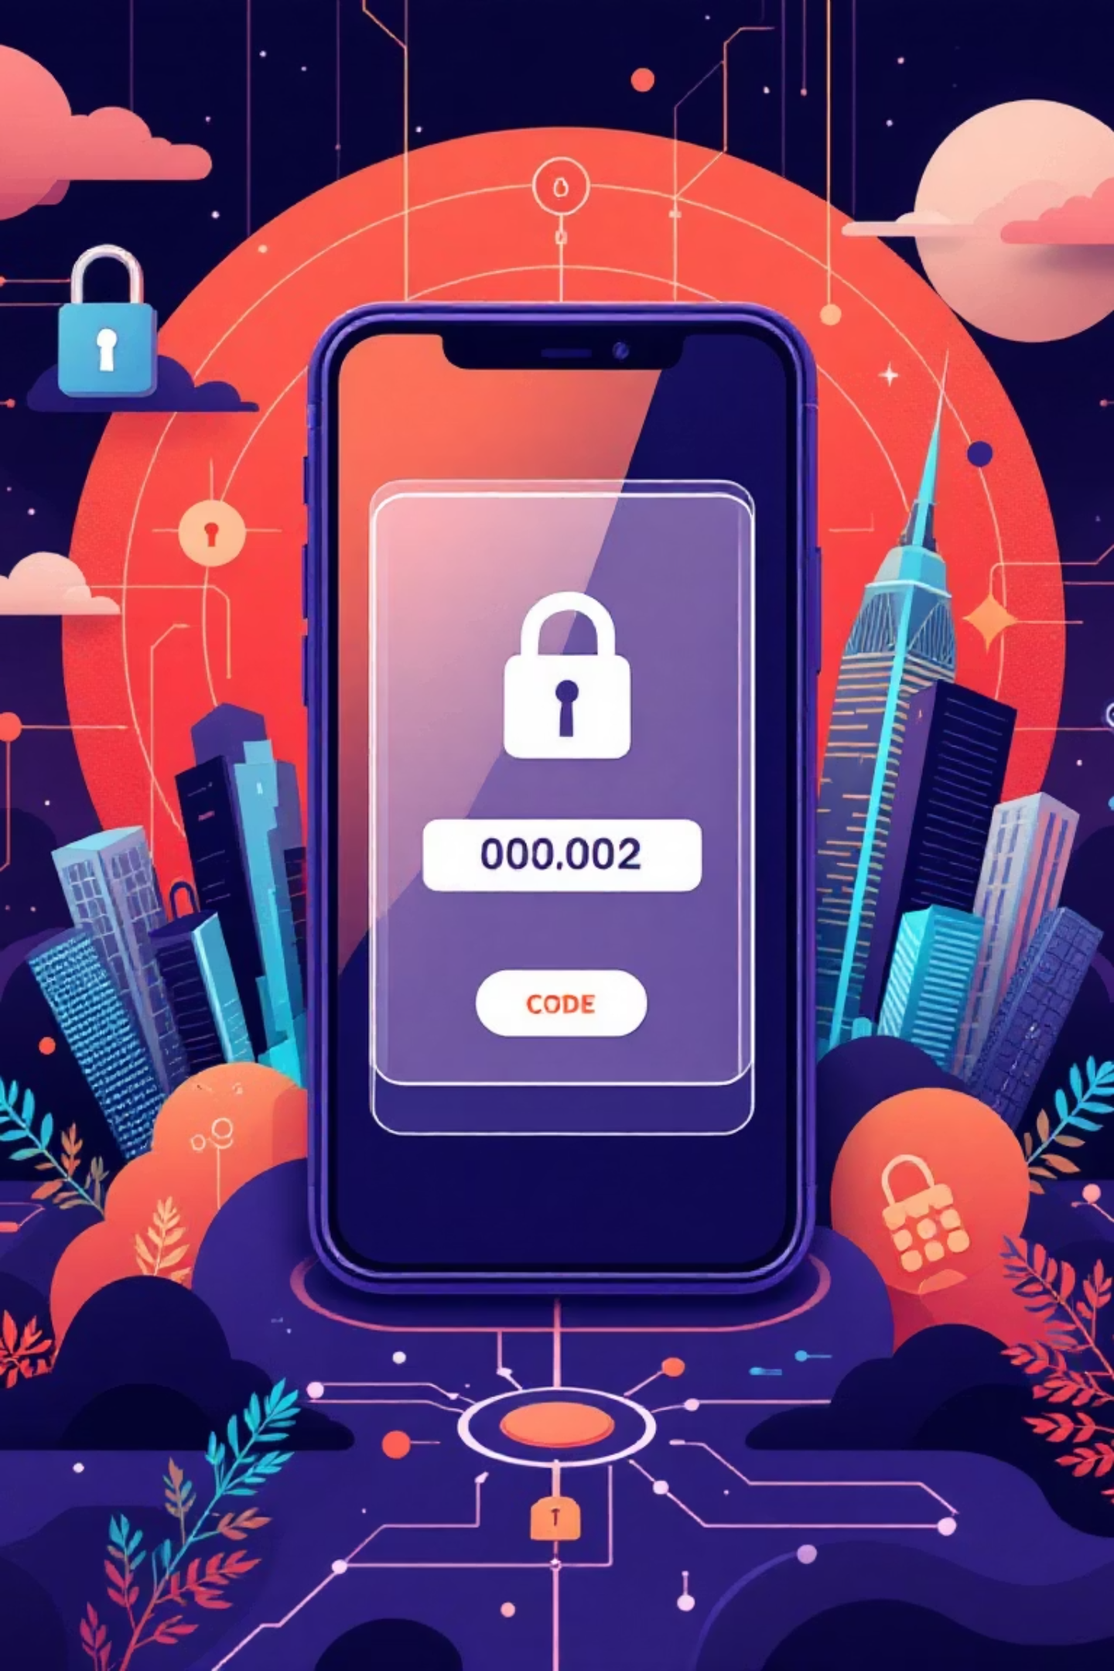
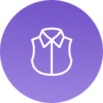
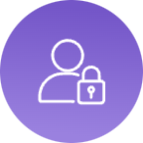
Multi-Factor Authentication (MFA): Your Second Lock
MFA significantly strengthens your online security by requiring more than just a password to gain access to your accounts. It's an indispensable defense in today's digital world.
Defining MFA
MFA requires two or more distinct verification factors (e.g., password, phone, or fingerprint) to confirm your identity.
The Critical Benefit
Even if an attacker steals your password, they are blocked from accessing your account. They lack the additional verification factor, providing a robust layer of protection.

Slide 13
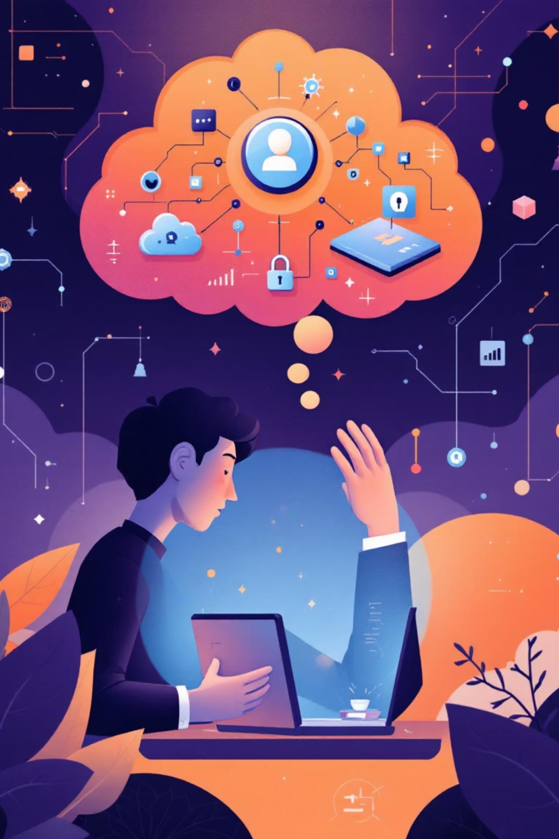

Think Before You Click: Human Firewall
While technology provides many strong defenses, the human element remains the most significant vulnerability in cybersecurity.
Public Wi-Fi Vigilance
Link Scrutiny
Be extremely cautious when using public Wi-Fi networks, as they are often unencrypted and vulnerable.
Before clicking any link, especially in unexpected emails or messages, always hover your mouse over it (on desktop) or long-press (on mobile) to reveal the actual destination URL.
Question Urgency & Unsolicited Contact
Maintain a healthy skepticism towards unexpected calls, emails, or pop-up messages demanding immediate action or personal information. Legitimate organizations rarely pressure you this way.

Slide 14
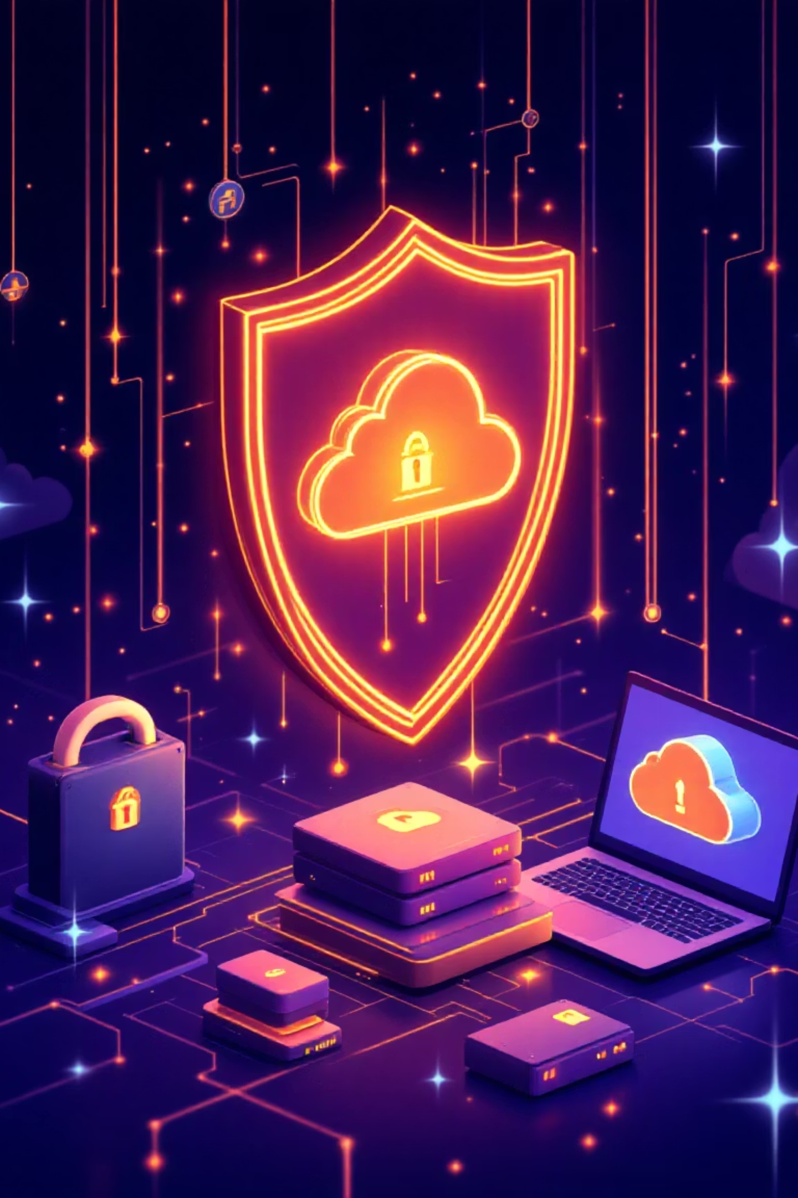

Backup, Backup, Backup: The Ultimate Lifesaver
In the digital age, losing your precious photos, critical documents, or business data can be devastating. Data backup is your ultimate safety net, ensuring continuity and peace of mind.
The 3-2-1 Rule: Your Backup Strategy Blueprint
Follow this universally recognized best practice to create a robust and resilient backup system:
3 Copies of Your Data
2 Different Media Types
Maintain at least three total copies of your important data: your primary data and two backups.
Store your backups on at least two different types of storage media (e.g., internal hard drive, external SSD, network-attached storage, cloud service).
1 Offsite/Offline Copy
Keep at least one copy of your backup data physically separated from your primary location, either offsite (like a cloud service) or offline (unplugged external drive).
Adhering to the 3-2-1 Rule is not just good practice; it's the only true defense against ransomware attacks and other catastrophic data loss events.

Slide 15
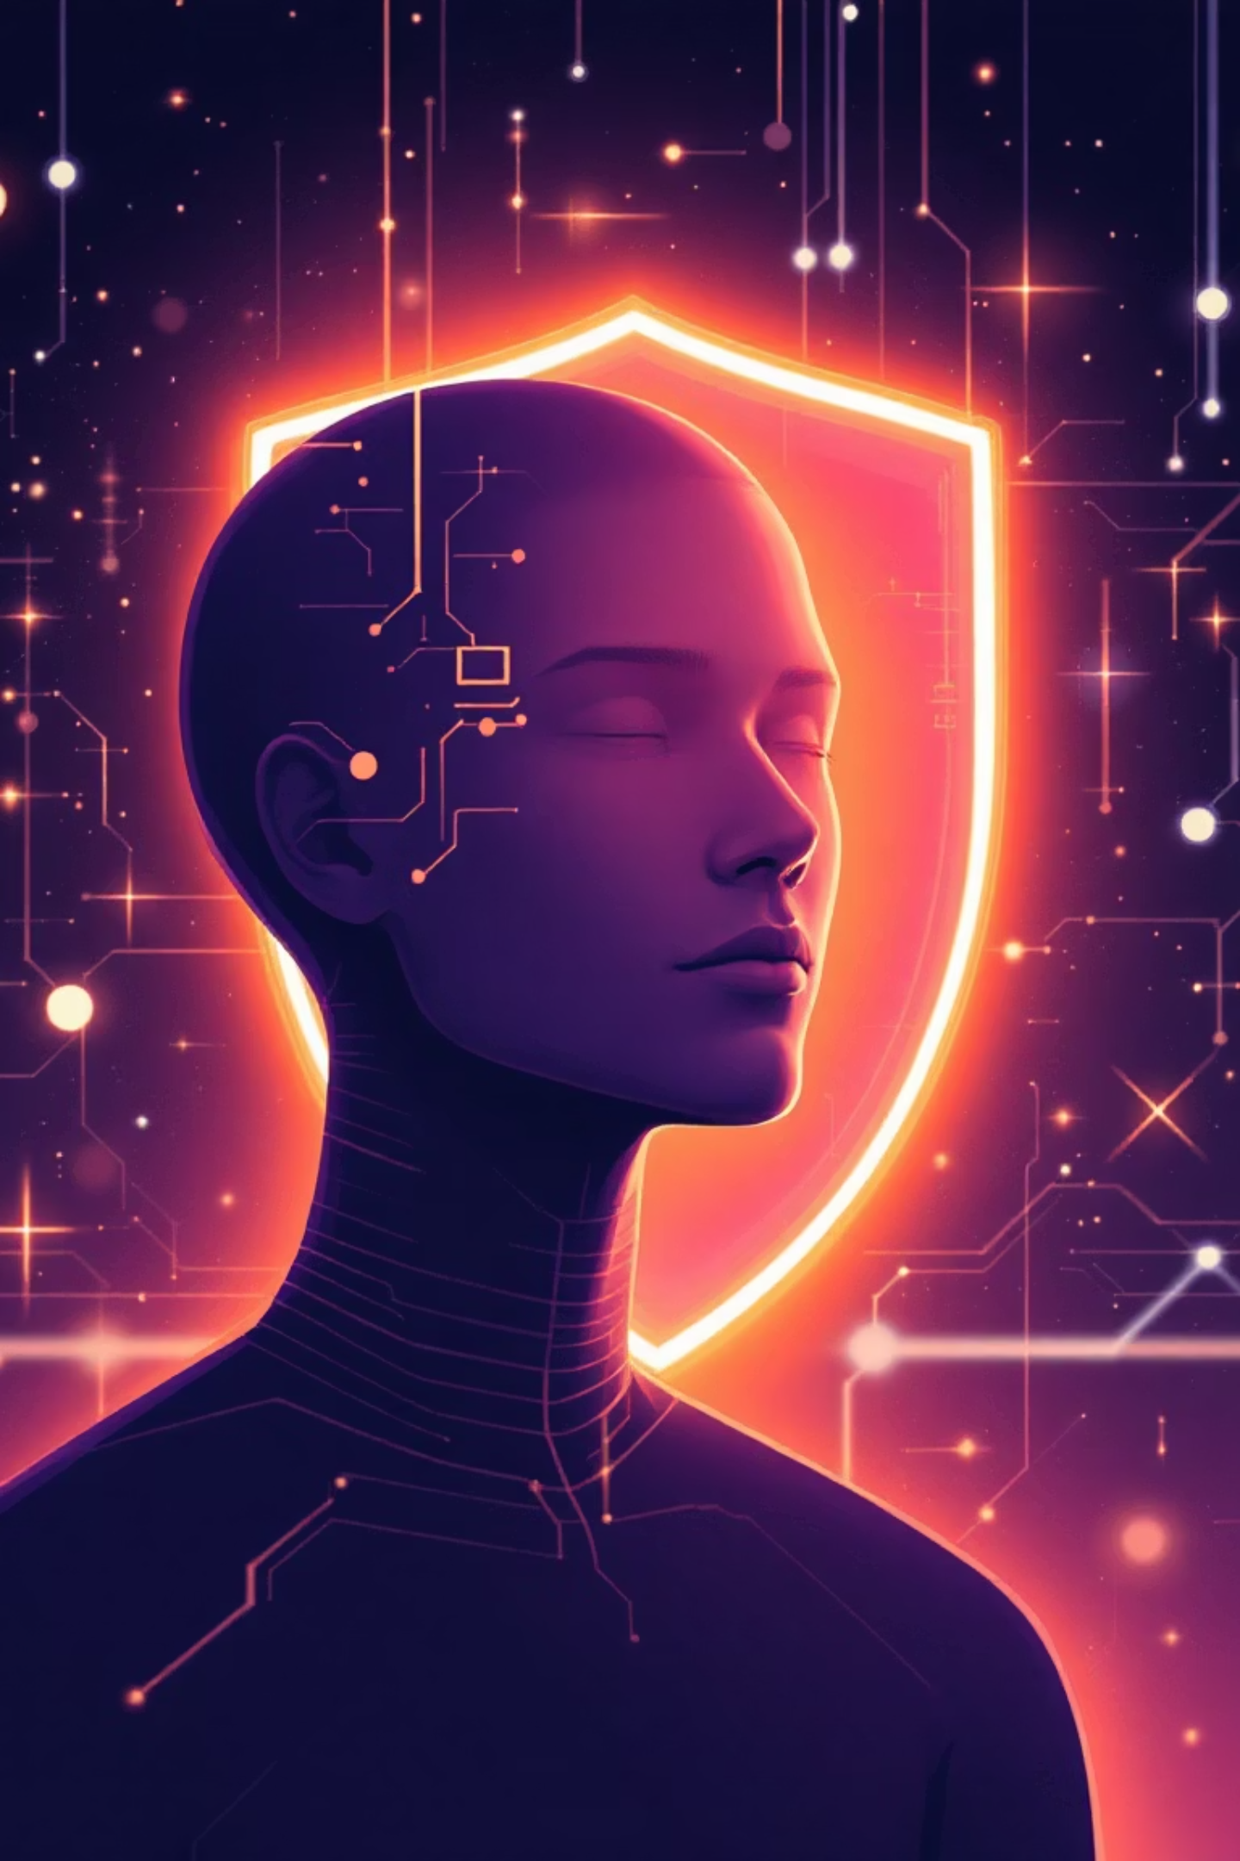
The Future of Protection: AI and You
As cyber threats become more sophisticated, so do our defenses. Integrating cutting-edge AI with fundamental human awareness creates an adaptive and robust security posture.
Zero Trust Architecture
The principle is simple: “Never trust, always verify.” This modern security model assumes no user, device, or network is inherently trustworthy, demanding rigorous verification for every access attempt, regardless of location.
Your Human Firewall
While AI and advanced systems are crucial, the most important firewall is YOU – human awareness. Your vigilance against social engineering, phishing, and suspicious activity is an irreplaceable layer of defense.

